Slide 1


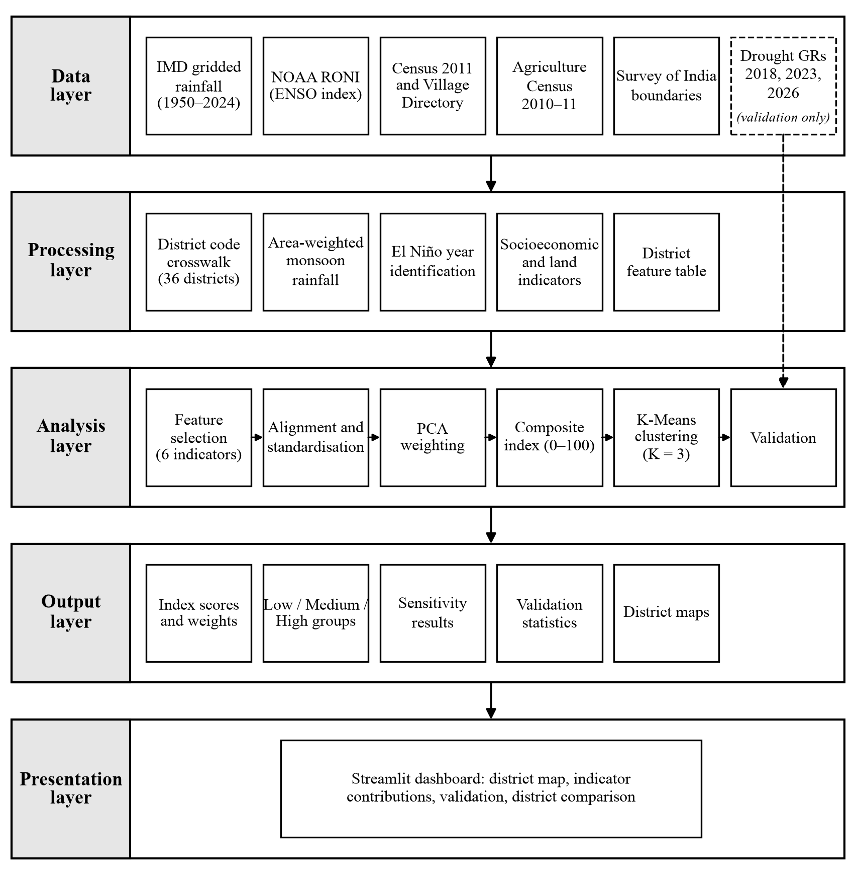
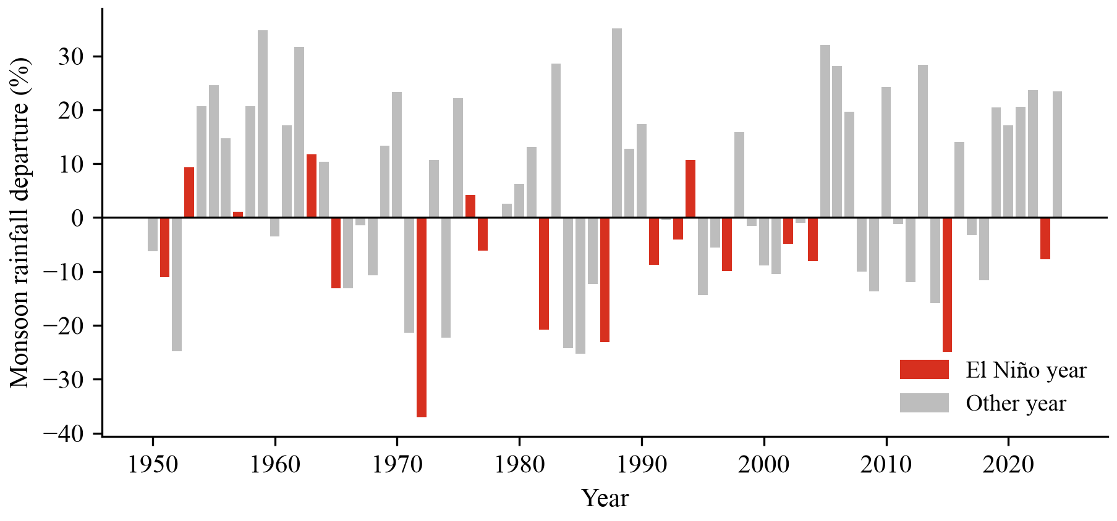
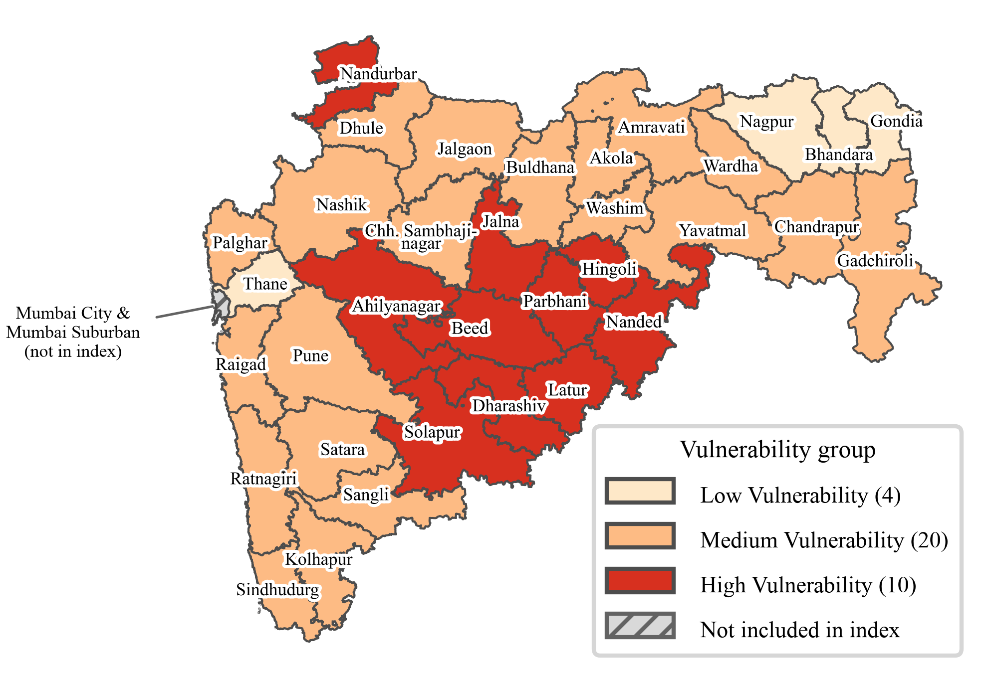
K. J. SOMAIYA INSTITUTE OF
TECHNOLOGY
Department of Artificial Intelligence and Data Science
AI-Driven Vulnerability Index Mapping for Districts in Maharashtra
to El Niño Droughts Using Socioeconomic and Climatic PCA
Tanishq Mewada, Saad Patel, Peeyusha Patki
Guide: Prof. Pankaj Deshmukh
Abstract
El Niño years often bring a weak monsoon and drought to Maharashtra, but how badly a district is hurt depends on how much it relies on rainfed farming and how well it can cope. This project builds a relative El Niño drought vulnerability index for 34 districts of Maharashtra. Two El Niño rainfall indicators, derived from 75 years of IMD gridded rainfall and NOAA's Relative Oceanic Niño Index (RONI), are combined with four agricultural and socioeconomic indicators from the Census 2011 and the Agriculture Census. Principal component analysis (PCA) gives the indicator weights, K-Means clustering groups the districts into Low, Medium and High vulnerability, and the result is checked against government drought declarations and shown in maps and an interactive Streamlit dashboard.
Background
Figure 2: System architecture of the vulnerability mapping system
Kharif agriculture in Maharashtra depends on the June to September monsoon, and El Niño conditions in the Pacific have often weakened it. In 13 of the 18 El Niño years since 1950 the average monsoon of the study districts was below normal (Figure 1). Rainfall alone does not show who suffers most: on average 64.9% of workers in these districts depend on agriculture and 81.2% of the net sown area is rainfed. Existing district studies mostly use expert or equal weights, do not link exposure to El Niño and are rarely checked against official drought records.
Result and Discussion
The six weights lie between 0.151 and 0.183. Beed is the most vulnerable district (100) and Nagpur the least (0). K-Means places 10 districts in the High group, 20 in Medium and 4 in Low (silhouette 0.587), and seven of the eight Marathwada districts are High (Figure 3). The index agrees with the share of talukas declared drought-affected in 2018 (Spearman ρ = 0.585), 2023 (0.450) and the 2026 holdout (0.545), and the ranking stays stable across six alternative methods (ρ = 0.934 to 0.995).
Figure 1: Average June to September rainfall departure of the 34 districts, 1950 to 2024 (El Niño years in red)
Objectives
Figure 3: K-Means vulnerability groups of the 34 districts
●
To collect and integrate official district-level climatic and socioeconomic data for Maharashtra, and to derive El Niño-specific rainfall indicators from 75 years of IMD rainfall and NOAA's RONI.
Conclusion
●
To construct a PCA-weighted composite El Niño drought vulnerability index on a 0 to 100 scale for 34 districts.
The project gives a transparent, reproducible ranking of El Niño drought vulnerability for Maharashtra. Vulnerability is highest in Marathwada and the dry interior, where El Niño rainfall losses meet rainfed farming and lower literacy. The index can support drought preparedness planning when an El Niño is forecast.
●
To classify the districts into Low, Medium and High vulnerability groups with K-Means clustering, and to validate the results against Government of Maharashtra drought declarations.
●
To present the index and groups through district maps and an interactive Streamlit dashboard.
Achievements
Paper submitted to the journal Geographical Research (Wiley), October 2026 (under review).
Methodology
Acknowledgement
Official data from seven sources (IMD rainfall, NOAA RONI, Census 2011, Village Directory, Agriculture Census, Survey of India boundaries and drought declarations) are joined on district codes (Figure 2).
This project was guided by Prof. Pankaj Deshmukh and supported by K. J. Somaiya Institute of Technology.
Six indicators are derived: ENSO rainfall slope, El Niño deficient-monsoon frequency, agricultural-worker share, rainfed share, small-holding share and literacy. They are aligned so that a higher value means more vulnerability, and standardised.
References
[1] D. S. Pai, M. Rajeevan, O. P. Sreejith, B. Mukhopadhyay, and N. S. Satbha, "Development of a new high spatial resolution (0.25° × 0.25°) long period (1901–2010) daily gridded rainfall data set over India and its comparison with existing data sets over the region," Mausam, vol. 65, no. 1, pp. 1–18, Jan. 2014, doi: 10.54302/mausam.v65i1.851.
PCA keeps three components (74.5% of the variance). Indicator weights come from the absolute loadings, and the weighted sum is rescaled to a 0 to 100 index. K-Means (K = 3) then forms the Low, Medium and High groups. The drought declarations are used only at the end, for validation.
[2] NOAA Climate Prediction Center, "Relative Oceanic Niño Index (RONI), ERSST.v6." [Online]. Available: https://www.cpc.ncep.noaa.gov/data/indices/RONI.ascii.txt (accessed Sep. 27, 2026).
[3] D. Swami and D. Parthasarathy, "Dynamics of exposure, sensitivity, adaptive capacity and agricultural vulnerability at district scale for Maharashtra, India," Ecol. Indic., vol. 121, Art. no. 107206, Feb. 2021, doi: 10.1016/j.ecolind.2020.107206.

